Slide 1
Getting started with SharePoint Framework
Office UI Fabric – React

Slide 2
Agenda
What are the Office UI Fabric React Components?
Available Components
Getting Started
How to use Office UI Fabric React Components
Q&A

Slide 3
What are Office UI Fabric React Components?
Office UI Fabric Components built with the React framework.
Built by Microsoft
Reusable patterns
Used in Office products
All about styling instead of JavaScript
http://dev.office.com/fabric#/components
Notes:
Fabric’s robust, up-to-date components are built with the React framework. Look through the component list to see the building blocks that are available using Fabric React.
Reusable patterns
Fabric’s components help you get buttons, navigation, and more that look like Office quickly and easily. They also contain extra functionality that helps your app act like Office too.
Used in Office products
Many Fabric React components are used in our products. We make improvements and bug fixes frequently, ensuring they work as designed across all of the supported browsers. https://github.com/OfficeDev/office-ui-fabric-react/blob/master/ghdocs/BROWSERSUPPORT.md
After you’ve explored the components, get started. http://dev.office.com/fabric#/get-started

Slide 4
Open Source
The Office UI Fabric project is developed and maintained by the OneDrive and SharePoint Design Studio in order to...
Help the development community build Office Add-ins and Office 365 web apps that integrate seamlessly with Office
Provide a point of reference for the evolving Office 365 design language that anyone can reference
Enable the community to contribute to better experiences for everyone who builds for Office

Slide 5
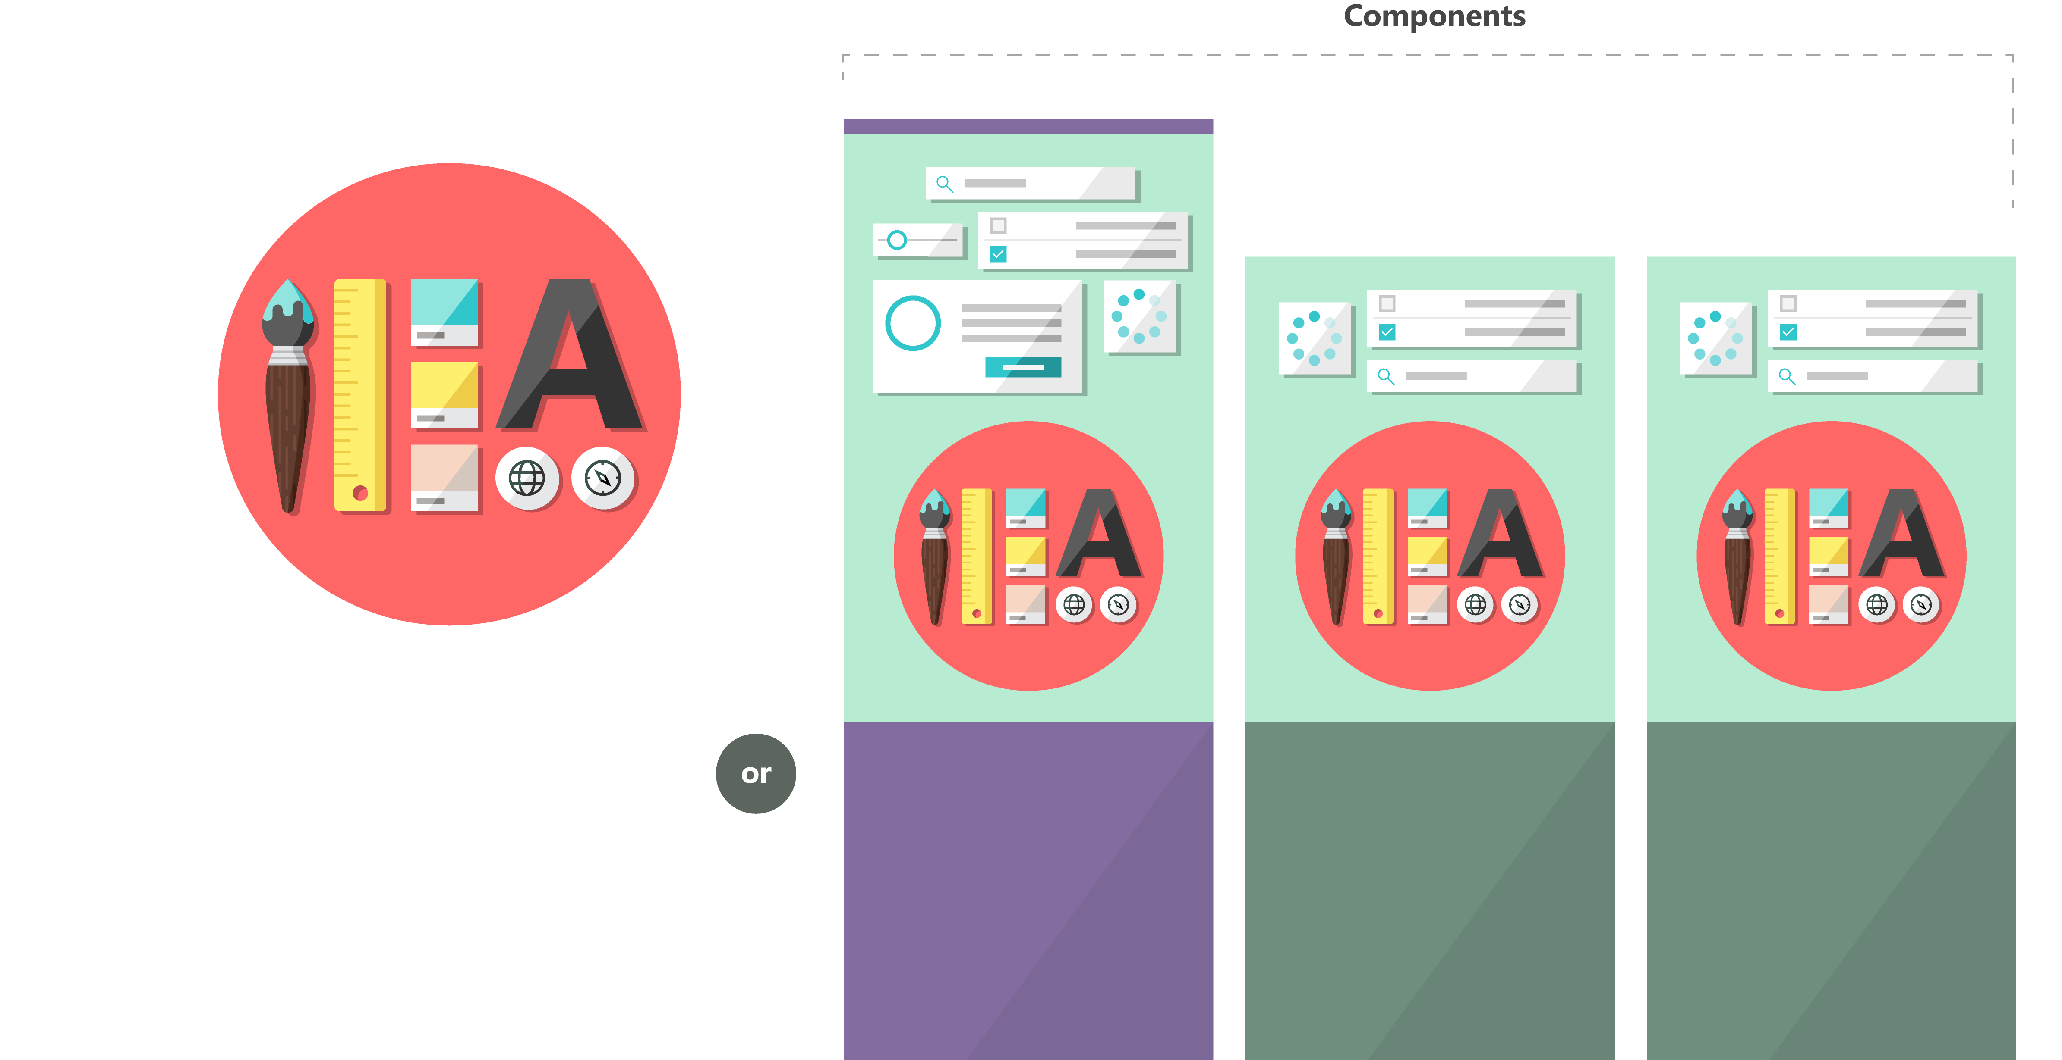

Fabric and its sub-projects
All depending on the Core, all open source
Community built
Fabric Core
Fabric React
Fabric JS
ngFabric
Fabric iOS
Core elements of the design language including icons, colors, type, and the grid
Robust, up-to-date components built with the React framework.
Simple, visuals-focused components that you can extend, rework, and build on.
Community-driven project to build components for Angular-based apps.
Native Swift colors, type ramp, and components for building iOS apps.

Slide 6
Monitor Releases and Contribute
Microsoft releases changes to the design language, components, and other assets frequently, and will make these updates available to the community.
If features are deprecated MS notes that in the change log, and the feature will be removed from the next major release.
Change Log
https://github.com/OfficeDev/Office-UI-Fabric-React/releases
Contribute In the GitHub Repository
https://github.com/OfficeDev/Office-UI-Fabric-React

Slide 7
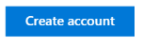
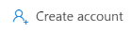
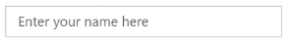
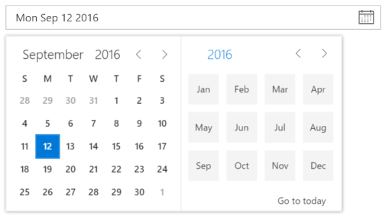
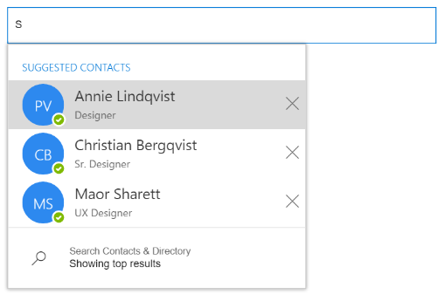

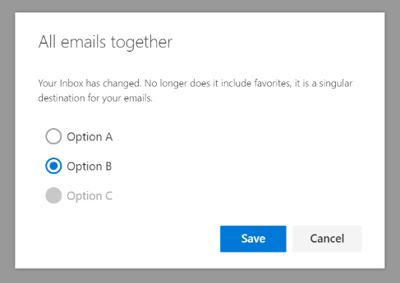
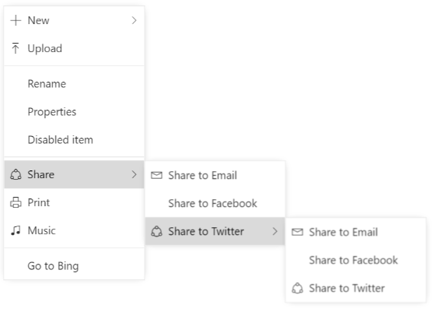
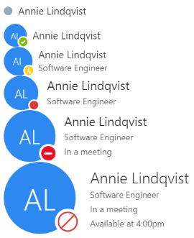
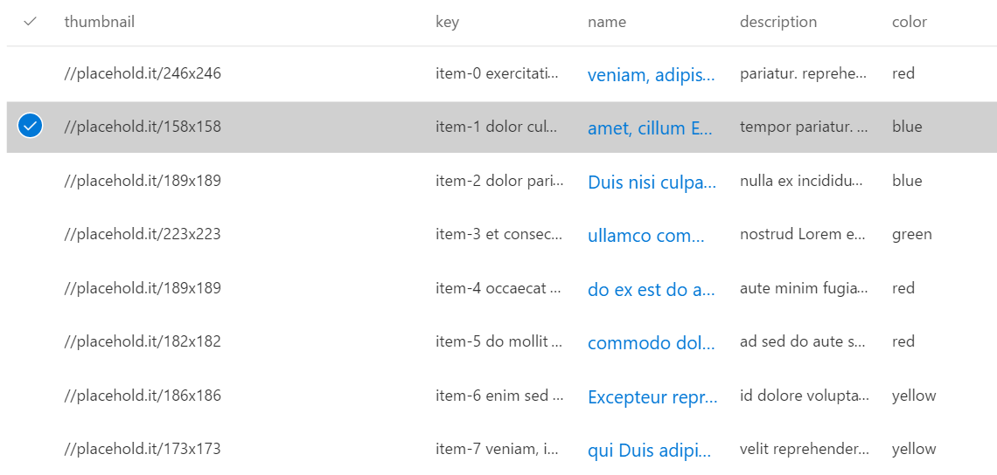
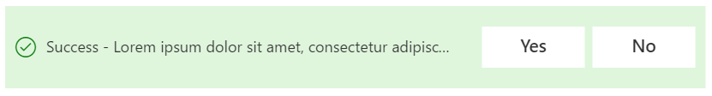

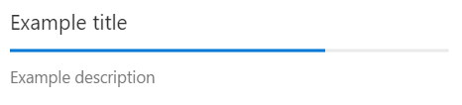
Fabric components - overview
Inputs
Button, TextField, Dropdown, Checkbox
Pickers
DatePicker, PeoplePicker, TagPicker, DocumentPicker, ColorPicker
Layout
CommandBar, Dialog, ContextualMenu, Callout, Panel
Content and People
List, Persona, FacePile
Informational
ProgressIndicator, Spinner, MessageBar
Notes:
Components are the building blocks, appropriately responsive.

Slide 8
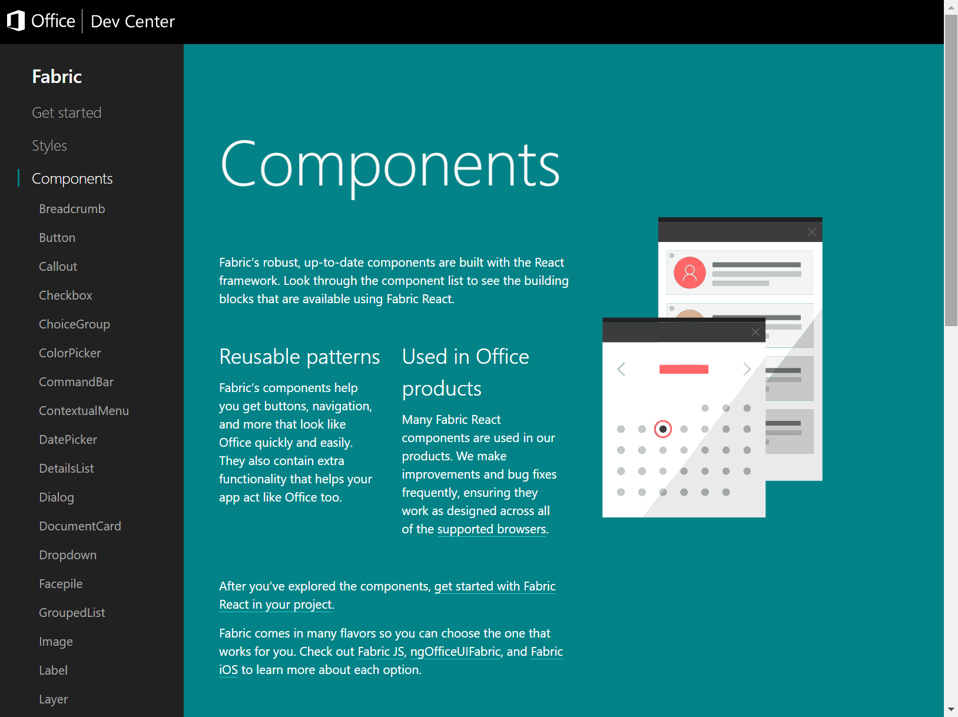
Browse available components
http://dev.office.com/fabric#/components

Slide 9
The Code
Office UI Fabric Developer Site
http://dev.office.com/fabric#/components
Get Started
http://dev.office.com/fabric#/get-started#react
OpenSource GitHub Repository
https://github.com/OfficeDev/Office-UI-Fabric-React

Slide 10

How to use Office UI Fabric React components
Install the Fabric React NPM package
npm --save install office-ui-fabric-react
Import components
import {
Button,
ButtonType
} from 'office-ui-fabric-react';
Use components in the Render method
public render(): JSX.Element {
return (
<Button buttonType={ ButtonType.primary }>ADD NEW ACTIVITY</Button>

Slide 11
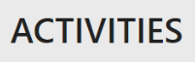
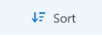
Using Type Styles and Icons
Type Styles for text elements
<span className="ms-fontColor-neutralDark ms-font-xxl ms-fontWeight-semibold">ACTIVITIES</span>
Icons
const contextualMenuItems: Array<IContextualMenuItem> = [];
contextualMenuItems.push({
key: 'Sort',
name: 'Sort',
icon: 'sortLines',

Slide 12
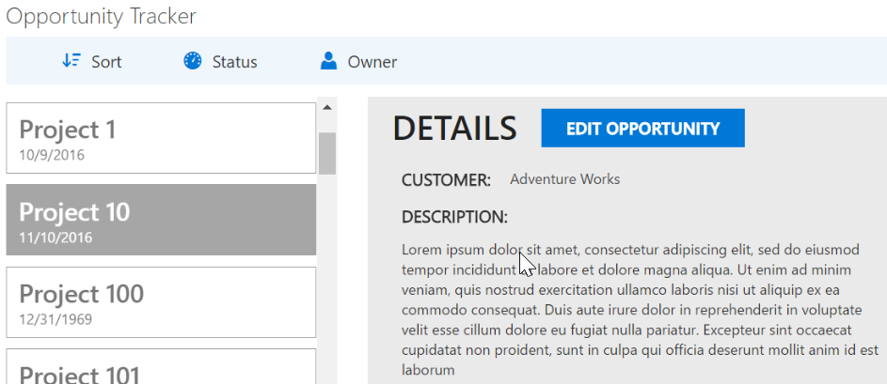
Combining custom styles with Office UI Fabric Styles
.menubutton{
display: none;
position: relative;
border-width: 1px;
border-style: solid;
padding: 16px 20px;
margin-bottom: 9px;
}
.menubutton > i{
position: absolute;
right: 10px;
top: 13px;
}
<div className={css("ms-fontColor-neutralSecondaryAlt ms-font-xl ms-fontWeight-semibold", styles.menubutton)}>

Slide 13
DEMO
Demonstration of using React components

Slide 14
Summary
What are the Office UI Fabric React Components?
Available Components
Getting Started
How to use Office UI Fabric React Components
Q&A

Slide 15

Sharing is caring…
Code samples and solutions
Reusable components
Guidance documentation
Monthly community calls
SharePoint Framework
SharePoint add-ins
Microsoft Graph
Office 365 APIs
http://aka.ms/SharePointPnP

Slide 16

Q&A

Slide 17


